Slide 1


VIP Buyer System
Our Exclusive

Slide 2

Our Mission is to Help You
Find The Best Home
At the Best Price
With the Least Amount of Hassle

Slide 3

With the Support of
Our Exclusive Home Hunter System
Our Unique Team System
Our Innovative VIP Buyer Programs
Our Leading Edge Technology
Our Specialized Knowledge

Slide 4
To explain how we do this, let me tell you how I’d like to proceed…
“First I’d like to explain Our VIP Buyer System to you, and how the process we use to help buyers find the place they will call home is completely different from the way other agents sell real estate.”
“Next, I’m going to spend some time talking about the Exclusive Consumer Programs we have developed as a direct result of our experience with hundreds of home buyers.
I’ll explain to you what these programs are, and how they will help you find the best home at the best price with the least hassle.

Slide 5

WARNING
There are two types of relationships that exist between Real Estate Agents
and Buyers:
Seller Agency – where the agent represents the Seller and owes “Fiduciary” duties to the Seller Only.
Buyer Agency – where the agent represents the Buyer and owes “Fiduciary” duties to the Buyer Only.

Slide 6

You probably know that any
aget can provide these services…
Services & Duties Provided: | Seller Agents | Buyer Agents
Arrange Property Showings |  | 
Assist with Financing |  | 
Provide Property Data |  | 
Explain Forms & Agreements |  | 
Monitor Closing |  | 

Slide 7

But…
Having Us Represent You as Your
Buyers Agent, We Can…
SERVICES & DUTIES PROVIDED: | Seller Agents | Buyer Agents
Protect Buyer’s Interests At ALL Times |  | 
Advise and/or Disclose to Buyer ALL MATTERS (even if it means pointing out reasons NOT to Buy!) |  | 
Prepare Property Value Study or CMA for Buyer (even if low) |  | 
Represent BUYER only |  | 
Structure Offers to Promote & Protect Only Buyer |  | 
Keep BUYER’S Financial capabilities, thoughts & willingness to pay more for a property strictly confidential |  | 
Represent BUYER on MLS Listed properties PLUS foreclosures, Bank properties, auctions, FSBOs & contractor built/sale properties |  | 
Negotiate Home Inspections, Repairs, Occupancy Dates & Buyer Credits & Costs in BUYER’S Favor |  | 
OWE FIDUCIARY OBLIGATIONS & RESPONSIBILITIES TO BUYER ONLY |  | 

Slide 8

There Are Additional BIG Benefits In Having US as Your Buyer’s Agent!

Slide 9

Our Team Will
Help You:
As Your VIP Buyer Agent…
Secure the best financing at the LOWEST rates and terms for YOU.
Beat Out Other Buyers to the Best Home for YOU.
Negotiate the Lowest Price & Best Terms for YOU.
Meet YOUR Home Buying Needs with the LEAST Amount of Hassle.

Slide 10

Shocking Fact!
According to Research and Survey’s
69% of Buyers
DO NOT GO BACK to
the same real estate agent to do another transaction
  *Based on National Association of Realtor Statistics

Slide 11
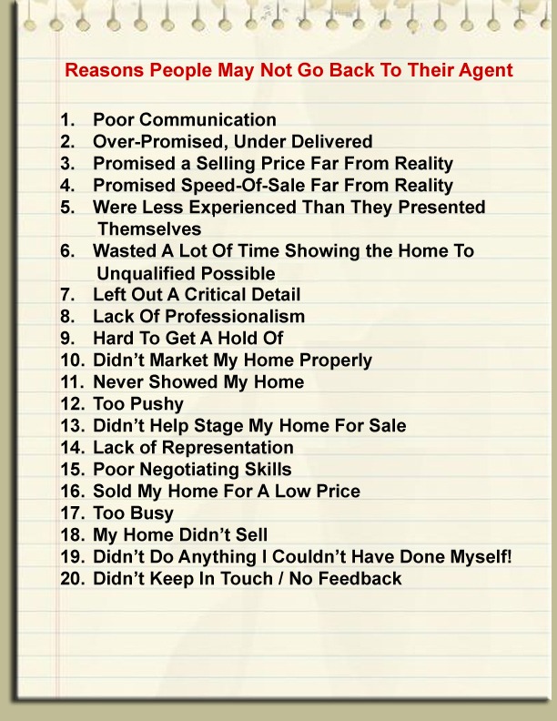
Reasons People May Not Go Back To Their Agent
Notes:
New pic

Slide 12
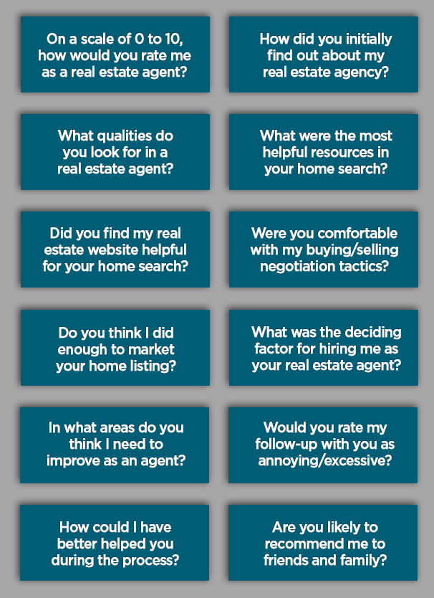
Our Most Recent Client Survey…
…Shows that 96.4% of our clients would come back to Our Team

Slide 13

The ABCs of
Real Estate Service
(What MOST Agents do!)
Advertise a home to get you to call them.
Beg you to come talk to them.
Choose a bunch of homes THEY like.
Drive you from house to house.
Encourage you to make an offer.
Feel frustrated because the homes THEY select are not to YOUR liking.

Slide 14

How Most Agents Operate
Most agents are one-man/woman shows with limited resources, time & energy, juggling several clients with little or no help and limited funds.

Slide 15

Our Team Approach
The Preferred Way of Serving Clients
In Most Other Fields of Business

Slide 16


The Ultimate Home Buying System
You get a whole team of professionals working for you
(versus a single agent)
Sales
Administration
TeleMarketing
Service
Marketing
Technology

Slide 17
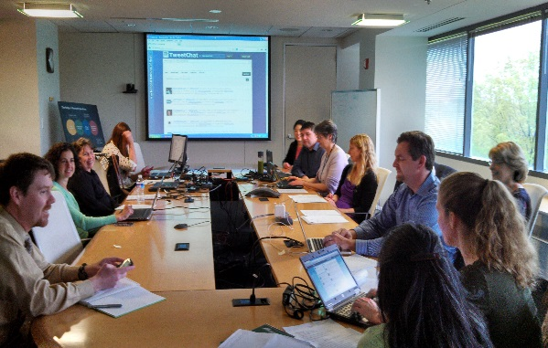




The Ultimate Home Buying System
Each Team Member Has A Specific Role
To Play In Helping you Buy Your Home
Marketing Department
Operations and Telemarketing Department
Technology Department
Customer Service Department
Sales Department
Notes:
Photos of people in those types of environments
Add department under each heading

Slide 18

The Ultimate Home Buying System
We never run out of time for you because
each of us is separately responsible for
a specific process in the buying of your home.
“I have More
Time to Spend
On Helping You
Find, Secure and
Buy the Place You
Call Home”
Your Home SOLD in 45 Days
BUY ANY HOME FROM ME,
AND IF YOU ARE
NOT SATISFIED IN 12 MONTHS
GUARANTEED
Or I’ll Pay You $1500!*
I Will Sell It For FREE!*
**CONDITIONS APPLY

Slide 19

Our Team Approach
When We Pull the Trigger on Helping You, There are 12 Key Systems that Activate to get You the Best Home at the Best Price with the Least Hassle

Slide 20

No Other
Real Estate Agent or Sales Team Offers YOU All These Buyer Services!
Your Home SOLD in 45 Days
BUY ANY HOME FROM ME,
AND IF YOU ARE
NOT SATISFIED IN 12 MONTHS
GUARANTEED
I Will Sell It For FREE!*
Or I’ll Pay You $1500!*
**CONDITIONS APPLY

Slide 21




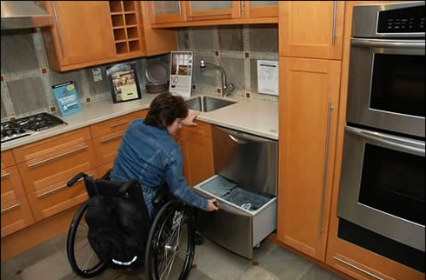

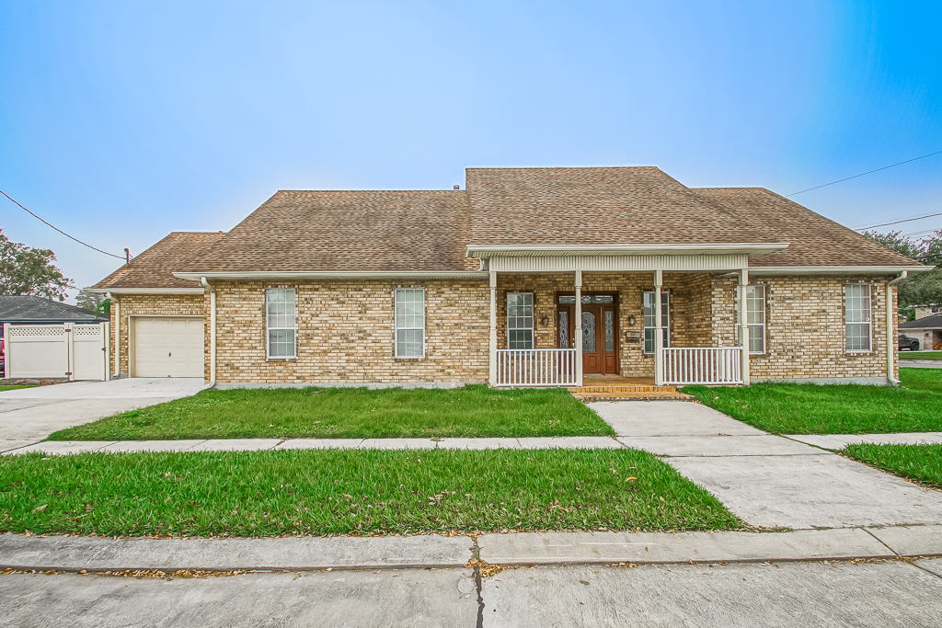
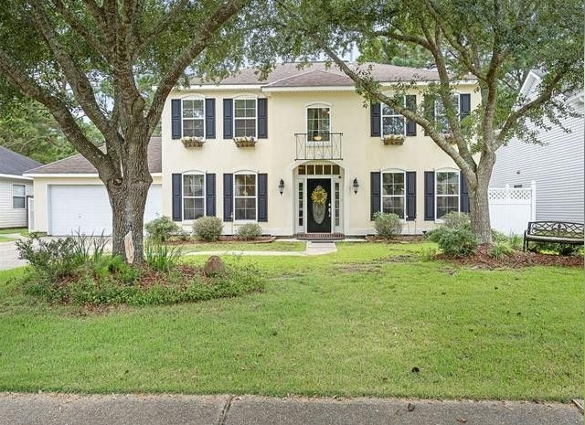
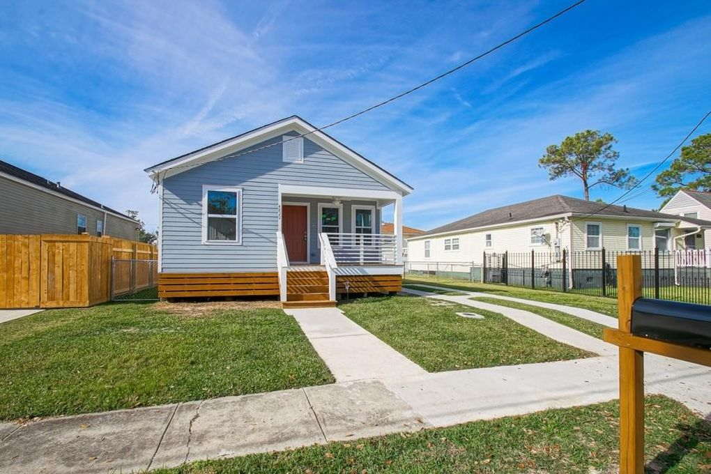
Our Exclusive VIP Buyer System
Focuses on YOUR Needs!
S O L D
S O L D
S O L D

Slide 22

Securing the Best Financing

Slide 23

Consider These Two Offers!
Buyer A (Not Pre-Approved) | Buyer B (Pre-Approved)
$325,000 | $325,000
Offer Conditioned on Getting Financing With No Assurance Of Loan Approval | Offer Made With Lender’s Written Pre-Approval Letter!
Uncertain Ability To Secure Purchase Funds | Financing GUARANTEED In Writing By Lender!
Which Offer Do You Think
The Seller Will Accept?

Slide 24
Securing the Best Financing
*We will assist you in securing the best financing program for your specific situation with the lowest interest rate and least expensive closing costs and have a pre-qualification/approval certificate generated to give you the best competitive advantage in purchase negotiations.

Slide 25

Securing the Best Financing
Three Key Benefits
You will know exactly how much home you
can afford before you start looking and how
much, if any, cash is required and what your
monthly payments will be.
You get the best financing (lowest rates,
most favorable terms and highest quality of
service) as a result of our long-standing
relationships with several of the best lenders
in the business.
You can make a stronger offer and beat out other buyers as a result of being pre-approved.

Slide 26
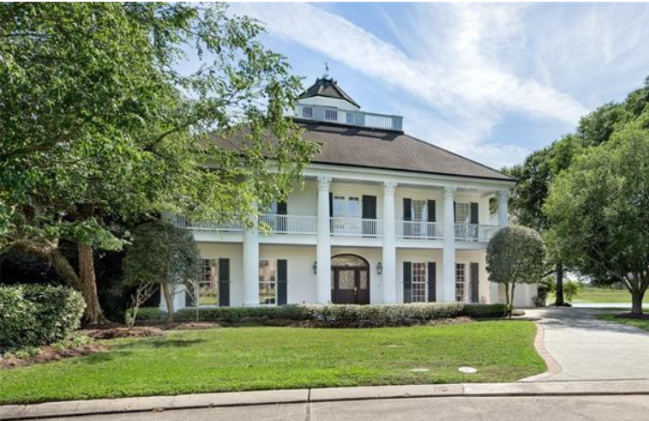
Pre-Approval…
As easy as 1-2-3
A Home Loan Credit Report is generated by a credit bureau.
Financial details are verified (income, employment, etc.)
A Loan Officer issues you
a Pre-Approval Letter.
4. You’re Pre-Approved!

Slide 27

Our One-of-a-Kind
VIP Buyer
Home Hunter System

Slide 28

How Most Realtors Pick Houses!
They make a random search through the MLS
They pick out 6 to 8 homes
They try to sell you one of them
The WRONG Person is deciding which houses you get to see!

Slide 29
Our One-of-a-Kind
VIP Buyer
Home Hunter System
We'll provide you with regular updates from our Home Hunter Service of all the new properties that match your home buying criteria. This will allow you to drive by and determine which properties you want to see.
We’ll research and locate properties not readily available online and contact you when one or more match your home buying criteria (unlisted properties, bank foreclosures, new construction, for sale by owners, etc.).

Slide 30

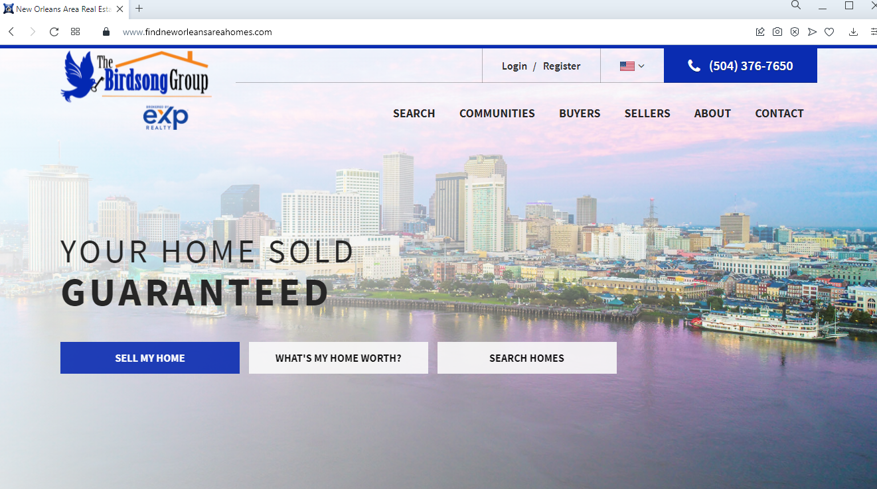
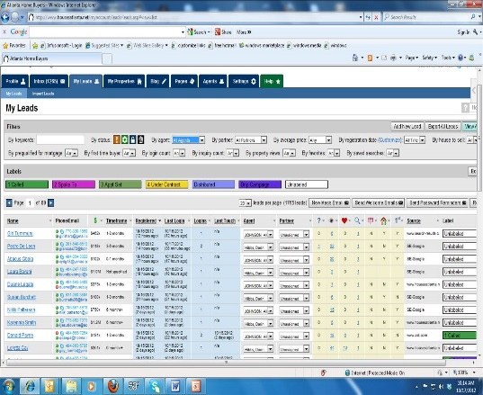
VIP Home Hunter Service ^{tm}
How It Works:
YOU tell us exactly what you
are looking for.
We enter YOUR criteria into our
powerful computer search program.
We send you regular emails with
computer generated lists of properties
that precisely match YOUR criteria.
YOU tell us what YOU are interested in and we look at and investigate the properties that YOU choose.

Slide 31
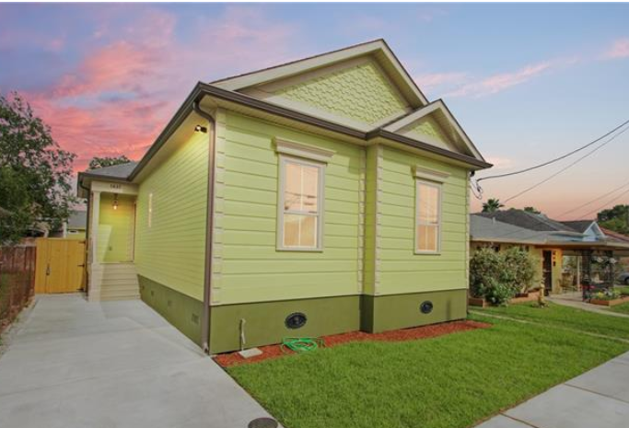
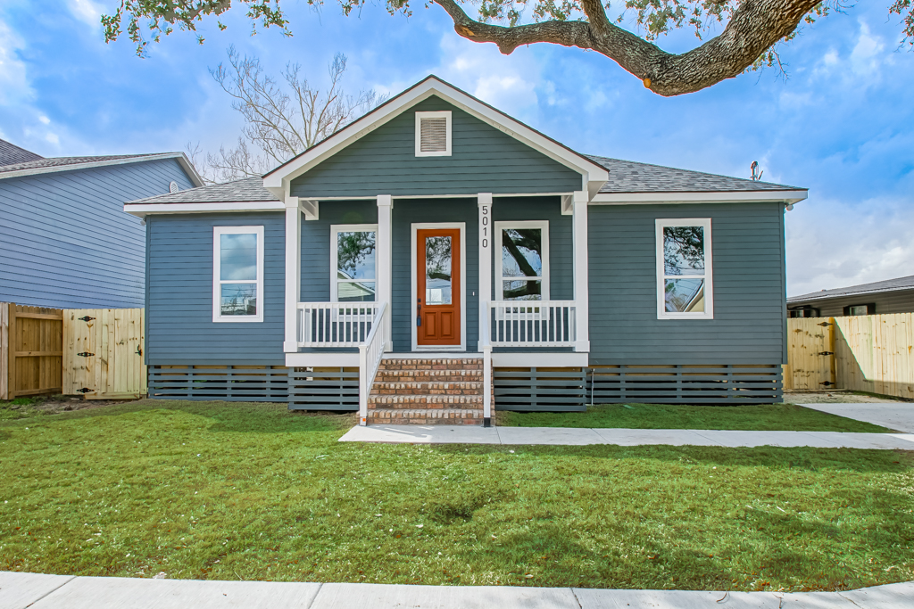

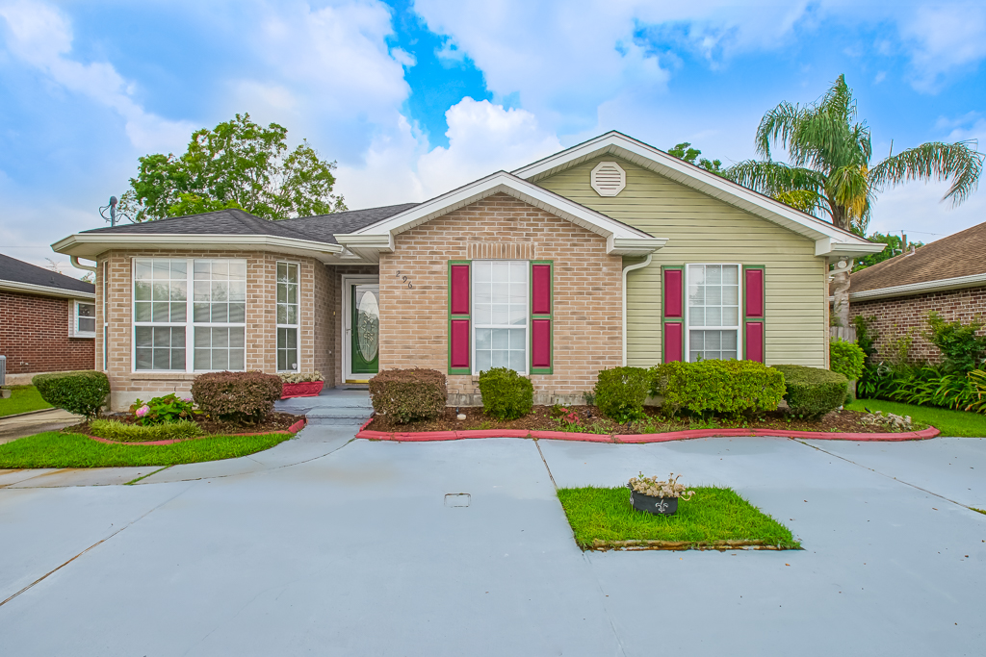
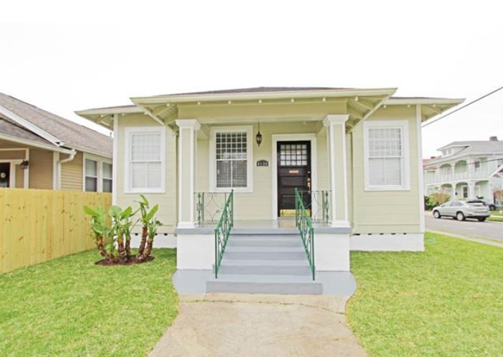
We Put YOU In Control!
YOU get to pick the homes you want to see.
YOU get to choose when you see them and drive by at your leisure!
YOU get all the info that the Realtors can see (including how much the present owners paid for the property and ALL the data from MLS system (not just the limited info the public can see.)

Slide 32
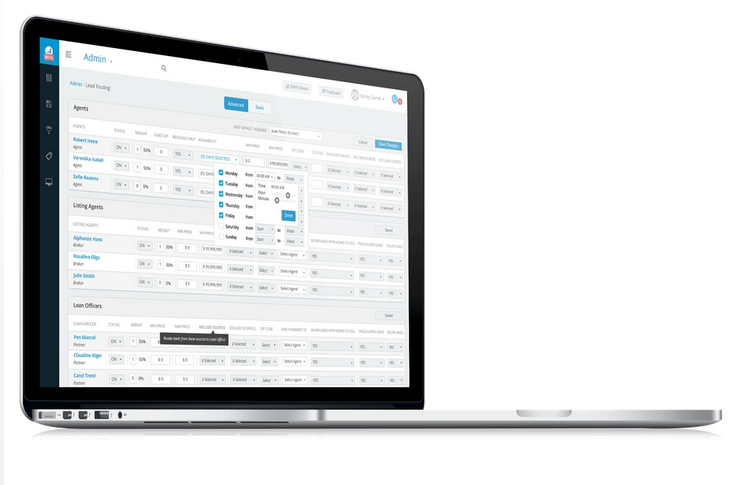

Specialized Market Knowledge
& Leading Edge Technology

Slide 33

Specialized Market Knowledge
Our Sales TEAM Agents are
full-time pros, completely familiar
with the intricacies of our local
market, its practices and inventory.
We know zoning, land use,
construction, real estate
development, investment and
a broad gamut of other real estate
related matters!
We regularly attend outside and in-house training, continuing education and seminars by experts in the field so that YOU have the benefit of the latest and most up-to-date information.
We have the latest state-of-the-art technology
computers, equipment and software, giving YOU
the competitive advantage over other buyers.

Slide 34
Specialized Strategy
We'll discuss the best strategy with you regarding
offer price
financing terms
interest rate
cost to close
possession date
inspection details
termite, pest and other environmental reports
and anything else you want to know when you are ready to purchase.

Slide 35
Offer Preparation
We'll help you prepare the offer with terms, provisions, special stipulations, amendments, exhibits and addendums weighted in your best interest.

Slide 36
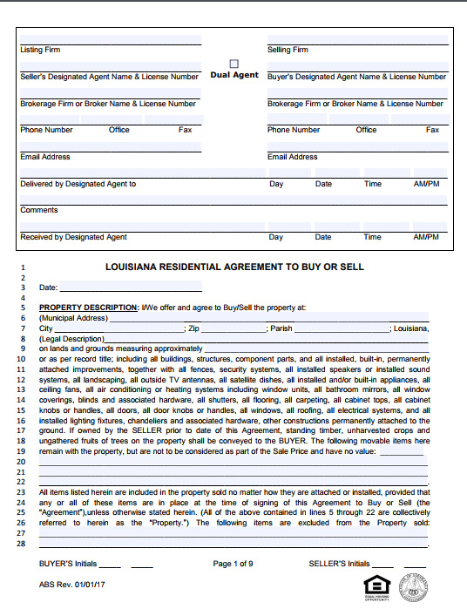
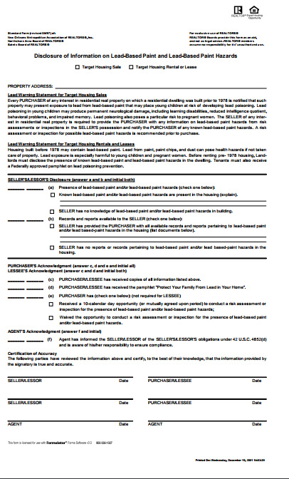
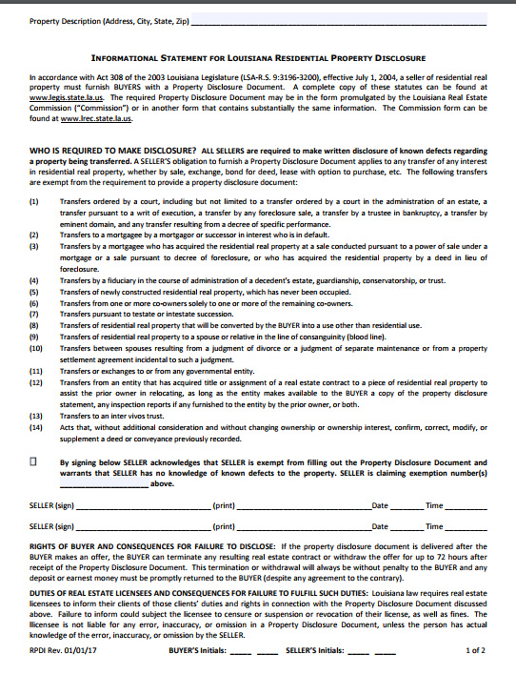

Slide 37
Negotiating
We'll present the offer on your behalf and negotiate in your favor to help you secure the property at the best possible price and terms.

Slide 38
Expert Help
We'll recommend extremely competent affiliates with respect to your total home purchase: including legal expertise, home inspection, appraisal, warranties, home owner hazard and title insurance.

Slide 39



Preferred Vendors
Your Home SOLD in 45 Days
GUARANTEED
Or I’ll Pay You $1500!*
BUY ANY HOME FROM ME,
AND IF YOU ARE
NOT SATISFIED IN 12 MONTHS
I Will Sell It For FREE!*

Slide 40
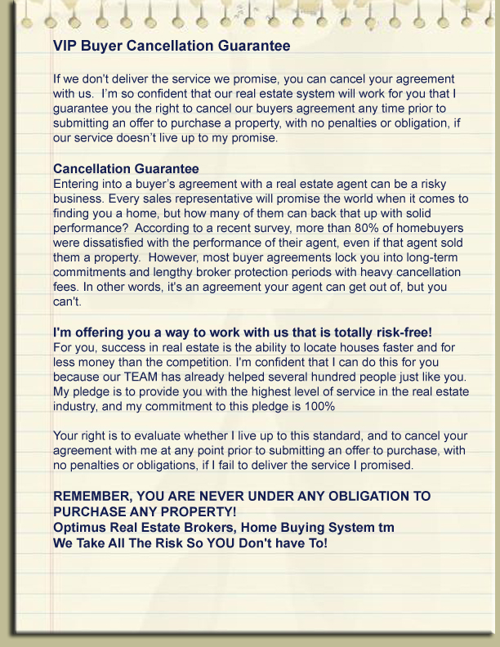

VIP Buyer Cancellation
Guarantee
The Birdsong Group

Slide 41


SMOOTH ON TIME CLOSING
We Close Your Transaction Quickly with the Least Cost and Hassle as a Result of Our
Exclusive VIP Buyer System

Slide 42
There Is A Difference In Just Buying a Home… and Buying Your Home RIGHT!

Slide 43
BIG REASONS TO LET US HELP YOU BUY YOUR HOME
Instead Of: | You Now Get:
Searching on-line or in newspapers at homes that may be already sold… | Priority Access to all the HOT New Listings BEFORE Other Buyers!
Wasting your time viewing only homes an agent has picked out for you… | Regular updates of homes that match YOUR criteria and YOU pick the homes you want to see!
Being pressured to Buy a home after a few showings… | Access to any and all homes, which you can see at your leisure and with NO pressure to buy!
Overpaying for the home you want… | The best possible price and terms because you beat out other buyers and don't have to compete with multiple offers and buyers!

Slide 44
Exclusive VIP Buyer Benefits
1. YOU Get Pre-qualified FREE of Charge for a Home Loan and get access to special financing. | You get more home for your money, you don’t waste time on homes above or below your price range & beat out buyers not pre-approved.
2. YOU receive the best new listings that match YOUR criteria BEFORE the average buyer knows about them! | You can beat other buyers to all the HOT NEW LISTINGS!
3. YOU are backed by our Specialized Market Knowledge. | You get the house you want at the lowest possible price and on the best terms and conditions.
4. YOU have an entire TEAM of Pros and Leading-Edge Technology at your disposal, at no extra cost! | Our State-Of-The-Art Technology and unique TEAM Sales System means you save time and money & your transactions are hassle-free.
5. YOU get a written Cancellation Guarantee, signed by us, that allows you to cancel if we do not live up to the promises we make! | YOU are in control, not the real estate agent. You get our signed, written commitment – we take all the risk so you don’t have to!
6. YOU get a written Satisfaction Guarantee, that insure you are satisfied with your purchase | If within 12 months you are not 100% satisfied with your new property we’ll sell it for you!*
7. You get priority access to competent affiliates that can assist you with your total home purchase needs and circumstantial details. | We have special relationships with Real Estate Attorney’s, Home Inspectors, Certified Engineers and others that can handle those special needs.

Slide 45
Put Our Team to Work in Helping You Find the Best Home at the Best Price with the Least Hassle!
Your Home SOLD in 45 Days
BUY ANY HOME FROM ME,
AND IF YOU ARE
NOT SATISFIED IN 12 MONTHS
GUARANTEED
I Will Sell It For FREE!*
Or I’ll Pay You $1500!*
**CONDITIONS APPLY

Slide 46
What to Say and Do When You
Come Across Homes on Your Own
If you see a home you like, feel free to call for info but always tell the agent that you’re working with us (this will prevent you from being hounded by other agents with questions and sales pitches.)
Get the price and (if available) the MLS number of the property and we will send you complete information.
If you see a house that is For Sale by Owner (FSBO), you should NOT contact them but send us the address and phone number so we can contact the home owner as your representative.
If you see a house you want to look at ALWAYS call Us for appointments.
Notes:
Music track under

Slide 47


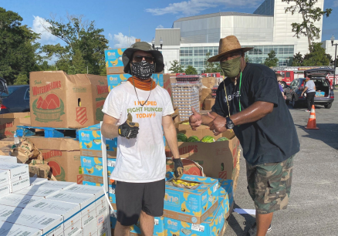

Your Referrals Feed The Hungry!

Slide 48
Your Referrals Feed The Hungry!
We are on a mission to raise $10,000 for the Second Harvest Food Bank. We do this by donating a portion of our income from homes we sell. We also take the time to volunteer as a Team to make a hands-on impact for children and families who are in need.
Second Harvest Food Bank does great work in aiming to end hunger by providing food access, advocacy, education, and disaster response. BUT, Second Harvest survives on Sponsorships and Donations. So… YOUR REFERRALS REALLY DO FEED THE HUNGRY.
Who do you know considering buying or selling a home you could refer to my real estate sales team?
Not only will they benefit from our award winning service, since we donate a portion of our income from home sales to Second Harvest, a very worthy cause benefits as well.

